Slide 1
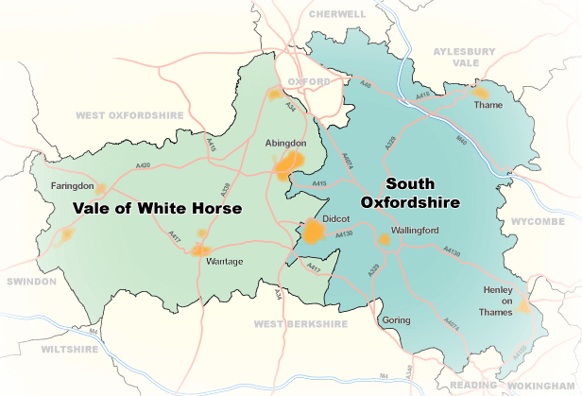

South and Vale Community Safety Partnership Plan 2025-2028

Slide 2
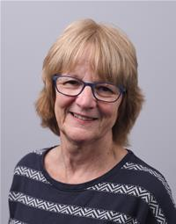

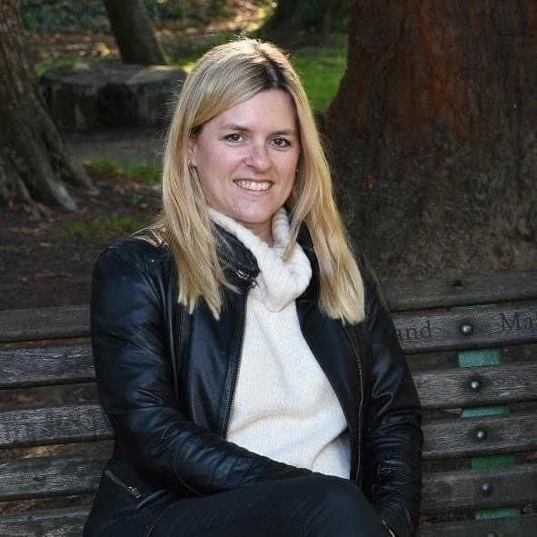
Foreword from South and Vale Community Safety Partnership Chair(s)
We are pleased to introduce the South and Vale Community Safety Partnership’s Plan for 2025-2028. This document details the priorities for South and Vale’s Community Safety Partnership (CSP) for the next three years.
Councillor Helen Pighills
Councillor Georgina Heritage

Slide 3
The plan sets out how responsible authorities, such as the police, district councils, county council, probation service, public health, fire and rescue service along with the voluntary sector, young people service providers and schools will work together to tackle crime and support vulnerable people.
It takes into consideration the findings from Oxfordshire’s Strategic Intelligence Assessment and the Police and Crime Commissioner’s Police and Crime Plan to ensure the South and Vale CSP has an evidence-based approach to tackling crime and supporting those people most vulnerable in our communities. The CSP will focus on four key priorities: anti-social behaviour, domestic abuse, exploitation and serious violence.
South Oxfordshire and Vale of White Horse is one of the safest places to live and work in Thames Valley and we are focused on keeping it that way, working with local organisations to reduce harm and support local services. By working together, we aim to make our communities safer and stronger.

Slide 4
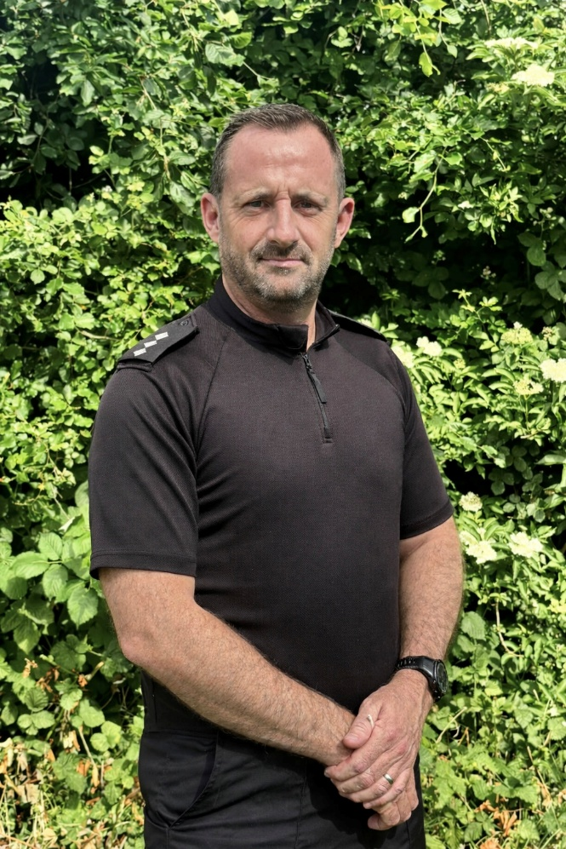
Foreword from the Chief Inspector Strategic Partnerships
I am the Chief Inspector for Partnerships within the Oxfordshire Local Command Unit of Thames Valley Police. South Oxfordshire and the Vale of White Horse covers a large geographical area and includes seven market towns. In recent years, the area has seen significant population growth, reflecting its strong appeal as a place to live and work.
Chief Inspector Nicholas Perks

Slide 5
The diverse geography and growing population of our communities present a range of complex policing challenges. However, through strong partnership working with our CSP, we continue to maintain some of the lowest crime levels in the Force. While this is encouraging, we are not complacent. We are committed to continuous improvement, with Thames Valley Police focusing on the core priorities of supporting victims, tackling crime, and building trust and confidence within our communities.
Policing continues to evolve, with increasing demand and new challenges emerging. Rises in serious violence led to the introduction of the Serious Violence Strategy in 2018, followed by the Serious Violence Duty, which came into force in early 2023. This legislation places partnership working at the heart of efforts to prevent and reduce violence. Thames Valley Police will continue to meet these legal requirements while embracing the opportunity to further strengthen partnerships to deliver meaningful reductions in serious violent crime.
Addressing serious violence remains a key priority, including tackling violence against women and girls (VAWG). Our VAWG strategy is centred on reducing harm, addressing all forms of domestic abuse, and increasing the number of offenders brought to justice. Alongside this, we are strengthening our approach to safeguarding vulnerable individuals through exploitation management, including responding more effectively to issues such as the exploitation of children by County Lines drug networks.

Slide 6

Anti-social behaviour (ASB) can have a significant and lasting impact on individuals and communities. It manifests in many forms, from neighbour disputes and inconsiderate behaviour through to graffiti and drug-related activity. Thames Valley Police remains committed to working closely with partners to protect residents and businesses, and to take action against those whose behaviour causes harm and distress.
The priorities set out in this plan will ensure that our collective efforts are focused on the issues that matter most to local people. By delivering against these priorities, we aim to strengthen public confidence, reduce crime, and support the wellbeing of our communities. Achieving this relies on effective partnership working, and Thames Valley Police is fully committed to working with CSP partners and our communities to deliver these shared goals for the benefit of all.

Slide 7
The South and Vale Community Safety Partnership (CSP) is a statutory body which brings local organisations together to tackle crime, protect vulnerable people and help people feel safe. No single agency can solve complex community safety issues alone, so CSPs provide a multi-agency approach.
The South and Vale CSP was created in accordance with the requirements of the Crime and Disorder Act 1998, which established the principles of partnership working. The partnership involves councillors and officers from both district councils and officers representing Buckinghamshire, Oxfordshire and Berkshire West Integrated Care Board, Thames Valley Probation Service, Oxfordshire County Council, Oxfordshire Fire & Rescue Service, Thames Valley Police, Soha Housing Limited, Sovereign Housing Limited and Office of the Police Crime Commissioner.
What is the Community Safety Partnership?

Slide 8
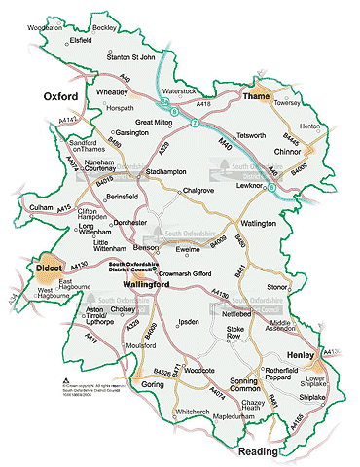
Demographic information
South Oxfordshire
It is estimated 151,820 people live in South Oxfordshire according to the Office for National Statistics: Mid-Year Population Estimates UK, June 2022.
In the 2021 Census The Office of National Statistics (ONS) recorded around 149,100 residents living in South Oxfordshire, an increase of 14,800 from the 2011 Census which equates to a 11.1 per cent increase.

Slide 9
The number of people aged 50 - 64 years rose by just under 5,100 (an increase of 19.5 per cent, while the number of residents between 35 and 49 years fell by just over 1,100 (3.6 per cent decrease). The average (median) age of South Oxfordshire is 43 years of age.
In 2021, 93.1 per cent of people in South Oxfordshire identified their ethnic group within the “White” category (compared with 96.1 per cent in 2011), while 2.3 percent identified their ethnic group within the “Mixed or Multiple” category (compared with 1.3 per cent the previous decade). The percentage of people who identified their ethnic group within the “Black, Black British, Black Welsh, Caribbean or African” category increased from 0.6 per cent in 2011 to one per cent in 2021.
The district of South Oxfordshire covers nearly 260 square miles. Its boundary reaches from the edge of the City of Oxford in the north-west along the borders of Buckinghamshire and Berkshire to the outskirts of Reading in the south. It has four main towns: Didcot, Henley, Thame and Wallingford, with Didcot becoming increasingly dominant as the main urban centre. Within 10 years, some 25 per cent of the district’s population will live in Didcot.
The housing-led forecasts show the population of South Oxfordshire increasing from 151,800 in 2022 to 166,100 by 2031 (+14,300, + 9 per cent). There is expected to be significant increases around Didcot, Culham, Chalgrove, and bordering Oxford Science Park. The population of Didcot and the surrounding area is expected to grow from 38,100 to 44,600 (+17 per cent).
South Oxfordshire

Slide 10
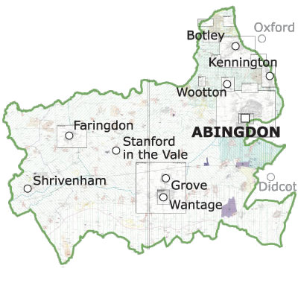
Demographic information
Vale of White Horse
It is estimated 142,116 people live in Vale of White Horse according to the Office for National Statistics: Mid-Year Population Estimates UK, June 2022.
In the 2021 Census The Office of National Statistics (ONS) recorded around 138,900 residents living in Vale of White Horse an increase of 17,900 from the 2011 Census which equates to a 14.8 per cent increase.

Slide 11
The housing-led forecasts show the population of Vale of White Horse increasing from 142,100 in 2022 to 163,300 by 2031 (+21,200, +15 per cent). There is expected to be a significant increase in population at Valley Park between Harwell and Didcot; Grove Airfield, Dalton Barracks, Crab Hill, Wantage and land north of Abingdon. The population of Abingdon is expected to grow from 45,100 to 49,400 (+9 per cent). The population of Wantage and Grove is expected to grow from 20,000 to 25,100 (+25 per cent) and the area west of Didcot in Vale is expected to grow from 14,300 to 19,400 (36 per cent).
The number of people aged 25 – 34 years rose by around 3,600 (an increase of 25.2 per cent), while the number of residents between 16 and 19 years fell by just under 150 (2.3 per cent decrease). The median age of Vale of White Horse is 41.
In 2021, 90.8 per cent of people in Vale of White Horse identified their ethnic group within the “White” category (compared with 94.9 per cent in 2011), while 2.5 per cent identified their ethnic group within the “Mixed or Multiple” category (compared with 1.3 per cent the previous decade. The percentage of people who identified their ethnic group within the “Black, Black British, Black Welsh, Caribbean or African” category increased from one per cent in 2011 to 1.7 per cent in 2021.
The district of the Vale of White Horse, whose name comes from the oldest chalk figure in Britain dating back to around 1000 BC, stretches from the edge of Oxford to the edge of the Cotswolds. The district has three historic market towns, Abingdon, Faringdon and Wantage. The area also covers Botley, located on the edge of Oxford, as well as the large village of Grove, near Wantage.
Vale of White Horse

Slide 12
Over the past twelve months (April 2024 to March 2025), the total number of recorded crime (excluding Fraud) in South Oxfordshire and Vale of White Horse is 13,325.
A total of 13,379 crimes were recorded in 2023-24, 13,631 recorded crimes in 2022-23 and 13,887 in 2021-22. Police recorded crime excludes offences that are not reported to or not recorded by the police. Trends can be influenced by changes in recording practices making it difficult to make long-term comparisons.
Crime data summary

Slide 13
Achievements
The South and Vale Community Safety Partnership has been successfully operating as a single Community Safety Partnership (CSP) since April 2011. For examples of some of the activities the CSP supported, please see the South and Vale CSP’s annual report to Joint Scrutiny Committee.

Slide 14
The South and Vale Community Safety Partnership will focus on four key priorities:
Domestic Abuse
Modern Slavery/ Exploitation
Serious Violence
Antisocial Behaviour
Keeping our communities safe
These priorities will form the main agenda of the community safety partnership meetings and partner updates will enable us to track the delivery and impact of our plan.
We will deploy our Community Safety grant received from the Police and Crime Commissioner to support these priorities and continue to invest in early interventions to prevent harm developing.

Slide 15
Keeping our communities safe
In addition to our established statutory duties, we will continue to measure crime data and will respond to any increases in demand. The CSP will review its performance on a quarterly basis, agree any remedial action necessary and provide an annual report to the district councils’ joint scrutiny committee.
Officers from South Oxfordshire and Vale of White Horse along with officers from Oxford City, West Oxfordshire and Cherwell collaborate on shared priorities at the Safer Oxfordshire Partnership Coordination Group. This officer-led coordination group oversees projects that are best placed at a county geographic level to prevent crime and support vulnerable people.

Slide 16
Working together to prevent violence in South and Vale
The Serious Violence Duty requires local authorities, the police, fire and rescue authorities, criminal justice agencies and health authorities to work together to identify and reduce serious violence in their areas.
Serious Violence includes specific types of recorded crime, such as homicide, grievous bodily harm, incidents that involve a knife, and areas of criminality where serious violence or its threat is inherent, such as in county lines drug dealing.
Priorities one to three encompass this responsibility and demonstrate how we plan to reduce the harm caused by serious violence across our areas.

Slide 17
PRIORITY 1:
Domestic Abuse
What is Domestic Abuse?
Domestic abuse is any incident or pattern of incidents of controlling, coercive, threatening, degrading and violent behaviour. Abusive behaviour includes physical or sexual violence, psychological or emotional control, economic, online or digital abuse.

Slide 18
Protecting People – Domestic Abuse Objectives
Co-ordinate sanctuary scheme works to help victims of crime stay and feel safe in their own home in accordance with the Oxfordshire Domestic Abuse Safe Accommodation Strategy 2025-2028
Promote domestic abuse and early intervention provision within the districts to strengthen communities
Commission Domestic Abuse Related Death Reviews and implement recommendations

Slide 19
PRIORITY 2: Modern Slavery and
Exploitation
What is Modern Slavery?
Modern Slavery is when an individual is exploited by others, for personal or commercial gain. Whether tricked, coerced or forced, they lose their freedom.

Slide 20
Protecting People – Modern Slavery & Exploitation Objectives
Ensure all modern slavery and exploitation concerns are reported and a multi agency approach and pathway is followed to support victims and disrupt activities.
Regularly assess the threat, risk and harm in South and Vale and use the findings to plan where we focus targeted work to ensure we meet our statutory duties under the Modern Slavery Act.
Working with secondary schools to deliver early intervention projects to raise awareness of exploitation to prevent and protect young people from harm and abuse

Slide 21
PRIORITY 3: Serious Violence
South and Vale Community Safety Partnership have agreed to focus on two key areas of serious violence; Violence Against Women and Girls (VAWG) and knife crime.
We are committed to creating an environment where women and girls can feel safe and be safe in South Oxfordshire and Vale of White Horse.
We will work together to tackle youth violence and deter people from carrying knives through early intervention and prevention.

Slide 22
Protecting People - Violence Against Women and Girls Objectives
Working partners to help women and girls feel safe within their community and challenge negative behaviours
Raising awareness of safe spaces and help available in our communities - Safe Places and Ask for Angela Schemes
Promote campaigns to educate and empower women and girls – White Ribbon, “It Does Matter” Lets lift the curfew – this girl can, “Enough. End violence against women and girls”

Slide 23
Protecting People – Knife Crime Objectives
Working with partners to help deter young people from carrying knives
Working with partners and agencies to raise awareness of support and help available in our communities – Victims First
Promote campaigns to help educate and reduce knife crime – The Ben Kinsella Trust, Stay True to You “Lets be blunt”

Slide 24
PRIORITY 4: Anti-Social Behaviour (ASB)
What is Anti-social behaviour?
Anti-social behaviour is defined as 'behaviour by a person which causes, or is likely to cause, harassment, alarm or distress to persons not of the same household as the person’.

Slide 25
Protecting Communities – Anti-social Behaviour (ASB)
Objectives
Carrying out environmental visual audits where there has been an increased demand on services, to identify solutions and improvements to areas
Support Thames Valley Police in delivering their ASB action plan
Explore a more joined up approach to tackling offensive graffiti in the districts and an improved partnership response to tackling ASB relating to cannabis smoke

Slide 26
Alternative formats of this publication are available upon request. The South and Vale Community Safety Plan will be reviewed, refreshed and modified annually.
Contact Us
For more information, please contact a member of the South and Vale Community Safety Team
01235 422592 (textphone users add 18001 before dialling)
communitysafety@southandvale.gov.uk
    southoxon.gov.uk / whitehorsedc.gov.uk

