Slide 1


South Oxfordshire and Vale of White Horse:
Resident Views on Waste Management
Final Report
January 2024

Slide 2


Background
Recycling rates in South Oxfordshire (63.6%) and Vale of White Horse (62.6%) are amongst the best in England. Both districts are proud of this achievement. However, over the last few years the amount of recycling collected hasn’t changed. In some areas it has fallen slightly. Data suggests that more that can be done to increase recycling and reduce the amount of waste going to landfill or for incineration.
Both South Oxfordshire and Vale of White Horse district councils work together on this issue. They run a combined waste collection and street cleansing service.

Slide 3
Objectives
The two councils are in the process of writing a new waste and street cleansing strategy.
To do this, evidence is needed to gain insight into how potential changes to the waste service might be received by the public. The key objectives of this research are to:
Understand resident views on waste management, recycling and street cleansing service across the districts.
Provide insight on resident motivations and barriers for reducing landfill waste.
Provide evidence on what residents feel are acceptable and unacceptable changes in waste management, recycling and street cleansing.

Slide 4
Sample
As a qualitative research project, we wanted a mix of participants who represent a range of views, experiences, households, ages, ethnicities, and to cover both districts
We conducted 7 remote focus groups with residents.
In total 41 residents engaged in the research.
All participants lived in key areas across the two districts.
The youngest participant was 20 and the oldest was 71.

Slide 5
Sample

Slide 6
Sample: Range of views
Participants were asked how important recycling was to them as an issue and how they ranked their own recycling habits. The table below illustrates participants’ combined responses.

Slide 7
Top Line Findings: Residents
A variety of views on waste management and recycling of household waste were expressed.
Individual convenience was a key motivator to behaviour.
There was confusion regarding what can and can not be recycled and what is meant by street cleansing.
There is no desire to change current bin collections and a reluctance for other changes.
Consensus that recycling is a key issue for Councils. Calls for solutions beyond household responsibility.
Levels of satisfaction were expressed towards current schemes in place.

Slide 8
Analysis: Key Themes
BINS: Thoughts on different bins, usage, capacity, space and collections
Bins
Recycling
CARBON AND RECYCLING Thoughts on a range of reducing carbon, recycling and reusing initiatives
Street Cleansing
STREET CLEANSING: Thoughts on attitudes, perceptions and street cleansing rotas
Recommendations
RECOMMENDATIONTS What could work to help increase recycling and reduce landfill

Slide 9
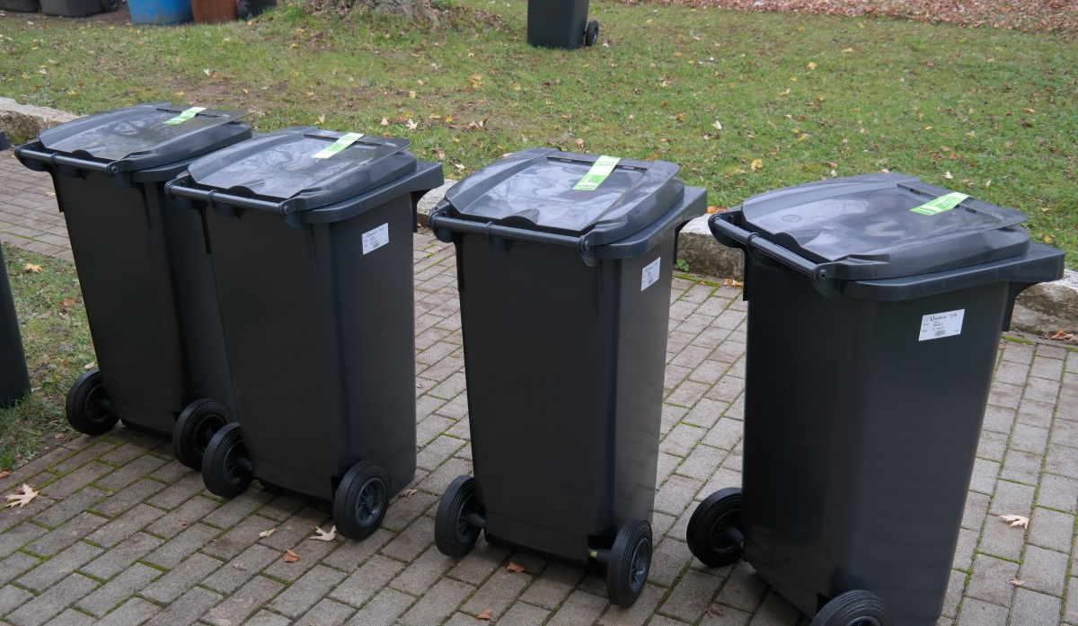
Bins
Participants were on the whole satisfied with current household waste management services. People new to the area made favorable comparisons to other councils.
Capacity was however considered at its max now. Any less frequent collections would be unacceptable. This was a unanimous view.
Not everyone had garden waste bins, and this was largely attributed to additional cost. Food waste bins were not popular largely due to smell.

Slide 10
Views on bins
This section covers key thoughts, issues and challenges people have around Kurbside collection.
Collection
Larger bins
More bins
Sorting
Residents feel they are at full capacity – especially larger households. Any reduced collection would not be popular
Increasing bin size is not a popular alternative to current fortnightly collection.
Practical concerns regarding storage, movement, smell (food, dog waste & summer)
More bins
unpopular. Confusion already existed regarding what goes where especially with children. Food waste was smelly. Additional space was also a barrier.
More responsibility on households to sort waste was unpopular.
Concerns this would demotivate and frustrate people.

Slide 11
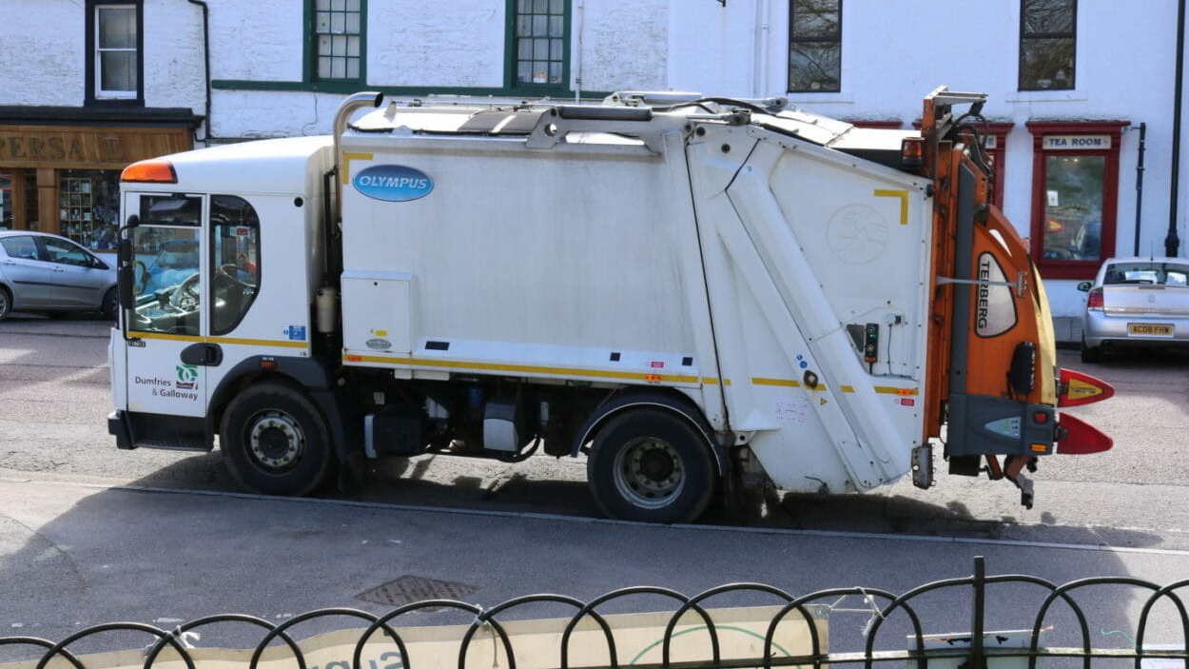
Kerbside Collection
I’ll be honest with you, I only used the food waste bin once. It was horrible and smelled. [Male, 40s]
Every week I have to literally climb in our bin to try and get more in… we’re full [Male, 50s]
We don’t have a brown bin as its expensive and I don’t think our garden rubbish warrants it .. We tend to just put it in general waste [Female, 30s]
More bins would put people off, they’d just put it in the big bin [Female, 60s]
I don’t think bigger bins wouldn’t work… they are quite heavy to move now so people might struggle taking it down the drive. Also, our bin is under the window and fits nicely, a bigger bin wouldn’t fit there [Female 40s]
We were really pleased when we moved here as the bins are so much better [Female, 30s]
This Photo by Unknown Author is licensed under CC BY-SA

Slide 12

Recycling
Recycling and carbon waste is considered important for wider society and for Councils. Reluctance from residents to do more.
Cynicism expressed by residents. Things feel like they are costing more and require more individual responsibility and result in less services
Need to find solutions to recycling beyond more pressure, inconvenience and responsibility on households. Desire for wider initiatives.

Slide 13
Views on recycling
This sections draws on the key issues raised in relation to the practicalities, motivations and barriers regarding household recycling
Convenience
Awareness
Responsibility
Ideas
The key motivator and barrier to household recycling is convenience for families. The easier and less time consuming the better
Perception that all the onus and responsibility placed on households. Want this to be shared
Want to see more shared learning across Councils, encouragement of better packaging, more local reusing/re-filling options.
Confusion, myths, misunderstanding, and fear of doing the wrong thing adds to more potential recycling going into household waste

Slide 14
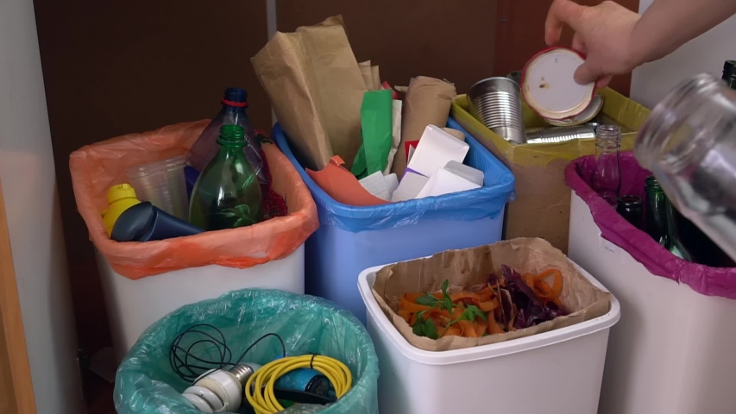
Barriers to Recycling
I think the main problem with recycling is not us but packaging. I agree we should reduce waste but most things I buy are in packaging I don’t think I can recycle [Male, 40s]
It’s important but my time is more important [Female, 30s]
I feel like rules [recycling] are constantly changing as well, like especially around like crisp packets and like packets of chicken and it has to be clean… and it just grosses me out a little bit. I'd rather just put it in the bin and be done with it.. I just don't really have time for that and not really interested in it. [Female 20s]
What is high value recycling?... They need to keep it [language] simple for people .. it adds to the confusion [Male, 50s]
I know that my kids just put everything in the main bin, they’re not bothered. [Female, 40s]
Sometimes I’m not sure what can be recycled and I’ve heard if you put the wrong thing in the whole area can’t be recycled. Its all contaminated!….. So I just put things I’m not sure about it the black bin [Female 30s]

Slide 15
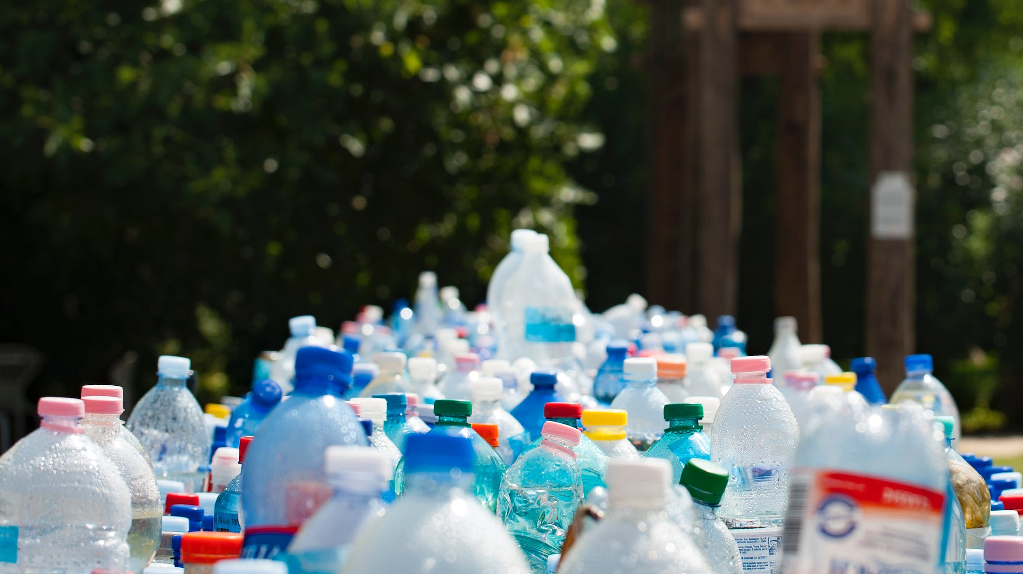
Beyond household responsibility
A lot of other developed countries have more technical ways of dealing with waste when it gets to the sorting centre, rather than having humans do it by hand at their homes [Male 40s]
Can they [the Council] not put more information on the app?.... The other day I didn’t know what to do with broken plastic toys [Female, 30s]
So why can’t they recycle things like egg boxes and pizza boxes? Other councils do? [Male, 40s]
If my recycling is full then I do just put it in the black bin… Maybe local supermarkets could help and have bins or something for like cardboard or something. I’d take it there instead if it was somewhere near and convenient [Female 50s]
If there’s a problem with their vehicles [waste collection] invest in more energy efficient vehicles. That’ll be better in the long term [Female, 50s]
I don’t know any local shops that do reusing containers. I’d do it for coffee and things but I’m not aware of anything here. [Female, 40s]

Slide 16

Street Cleansing
Largely satisfied with current levels of street cleaning although some confusion regarding who responsible for cleaning streets (council, maintenance, volunteers).
Mixed views regarding any potential changes to rotas or reduction of bins provided.
Attitudes to littering need to be addressed

Slide 17
Views on street cleansing
This sections explores understanding and concerns regarding street cleansing
Important
Rotas
Responsibility
Attitudes
Residents want clean streets. Any proposed changes would need to ensure this and reassure residents
Prioritising street cleansing is important especially areas with large foot-flow. Skeptical about waiting for street to be reported before cleansing.
Shared responsibility between individuals and Council. Individuals regarding dropping litter but Council on providing bins
Need for increased awareness raising regarding littering. Especially with younger people

Slide 18
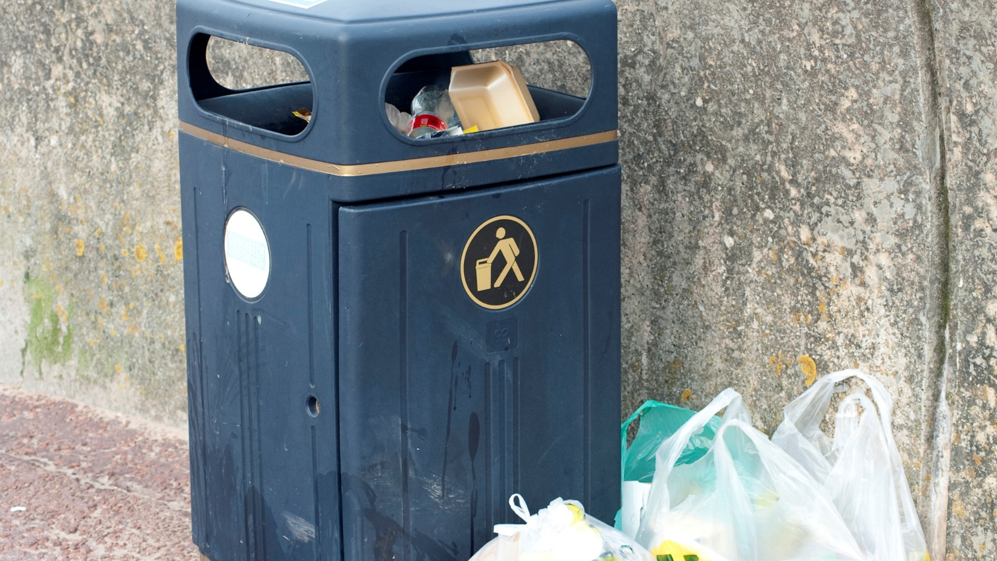
Clean Streets and Littering
I think the problem is more on the verges by roads. I think its more people throwing litter from their cars [Female, 60s]
Well it’s our responsibility to not litter. But if the bins aren’t emptied, I’d say that’s down to the Council [Female, 30s]
I think it makes sense for it to be focused on heavily littered streets, but then my concern there is when will they then clean the streets that aren't as heavily littered.. and therefore that becomes a buildup and then that becomes the dirty streets [Male 30s]
Its probably worth looking at the rota. Maybe have a graded system rather than an either or [Male, 60s]
I actually don't think it's a bad idea to focus on the heavier littered areas, because that just seems a good usage of funds to me. It makes more sense to focus there than a quiet street that hardly has any problems. What's the point cleaning that if it doesn't need it [Female, 40s]
In reality I wouldn’t call the Council [if street was littered]. I’d probably assume someone else was doing it. [Female, 50s]
I’ve seen kids dropping litter, like crisp packets and stuff. They don’t care [Female 30s]
This Photo by Unknown Author is licensed under CC BY

Slide 19
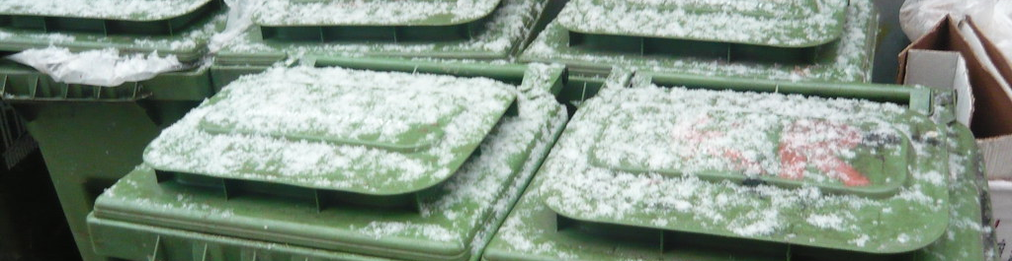
To Summarise
Household waste and recycling is a topic of interest for many residents
Individuals feel that too much responsibility, time and burden is already placed on them
Whilst there is a desire to reduce landfill, there is no appetite to their increase inconvenience or time
Any noticeable reduction in services would be unpopular in the current cost of living climate. There are already existing fears that people are ‘paying more for less’

Slide 20
Recommendations
Based on residents' views, solutions for reducing landfill could be achieved by the following:
Awareness
Campaigns
Local initiatives
Language
Working Together

Slide 21
Awareness
There needs to be greater awareness of the need for local recycling, household responsibility and recycling management processes
There does seem to be some reluctance to ‘do more’ when it comes to household recycling
Further recycling asks could risk more landfill waste as people place things in general waste out of confusion and inconvenience
Individuals are interested in this topic and want to help, but they also want to know more
Address Confusion
Process
Raise awareness of what can and can’t be recycled and address misunderstandings and myths. The use and promotion of existing apps will be beneficial.
More information on recycling sorting centres – what do they do and how does household recycling help and hinder. Use existing newsletters, website, videos to provide more information.

Slide 22
Campaigns
A public campaign on the role and purpose of reducing landfill would help motivate
Individuals are more motivated when they feel part of something and understand the greater purpose.
Reducing landfill and carbon can feel abstract for families struggling in the cost-of-living crisis.
Young people were mentioned as being less likely to recycle and more likely to litter.
Partnerships
Young people
Partnerships, campaigns and competitions with local community groups and schools would be beneficial. This can help mobilise fun and tangible action especially on recycling, reducing carbon and reducing littering.
Engaging with young people can also help to motivate wider members of the family.

Slide 23
Local Initiatives
There is pride in the local area and an interest in building the local economy and community
Local retail outlets could provide an alternative to heavily packaged online shopping.
Work with local communities and voluntary organisations on how they can keep the street clean and discourage littering
Build local momentum to help change attitudes and behaviour. Create a sense of ‘we are doing this together’
Partnerships
Momentum
Develop partnerships with local business, farm markets and retail outlets to promote less package items. Are there opportunities to develop and promote more reusing, refill options?
Work with supermarkets or areas of high foot flow to provide more recycling or overflow collection facilities.
What can local business and charities do to help with bulky items, reusing, upcycling?

Slide 24
Language
Language is key and can help motivate or demotivate households
Keep messaging simple and positive.
Remind people why reducing carbon and landfill is important. Why are things being asked of them especially when it is considered inconvenient.
Avoid jargon as this can confuse people. Generally, when people are confused, they are likely to put things into general waste.
Any inferences to cost cutting exercises will not be well received in the current climate – so use alternative approaches.
Simple
Effective
Use language such as partnerships and working together. This can help address current resistance when people feel a lot is already being of them.
Target messages to key audiences such as schools and young people
Use incentivising language

Slide 25
Working Together
The power of public engagement
Find platforms to engage with residents more on this topic.
Use this for them to understand more about your challenges.
Work together to find solutions across a range of ages and households.
Outreach work directly with communities and schools would be very beneficial.
Joint
Solutions
Engagement
Households are more likely to find changes palatable if it is presented and understood as part of a wider programme.
Explore opportunities with schools and community organisations. Are there local ‘reducing landfill champions‘?

Slide 26
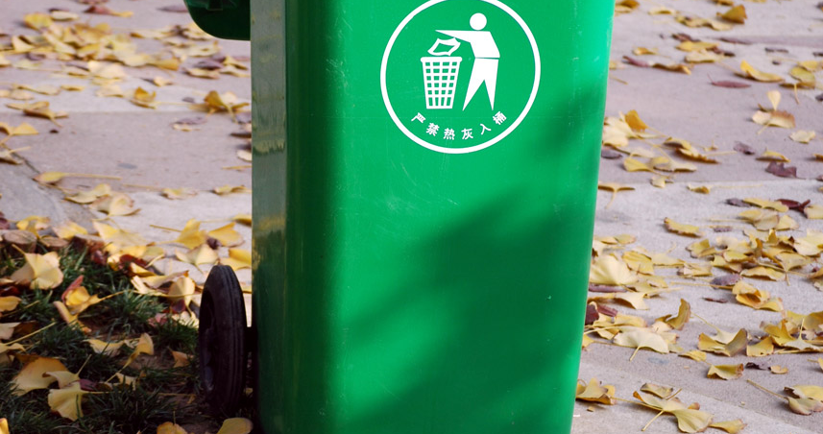
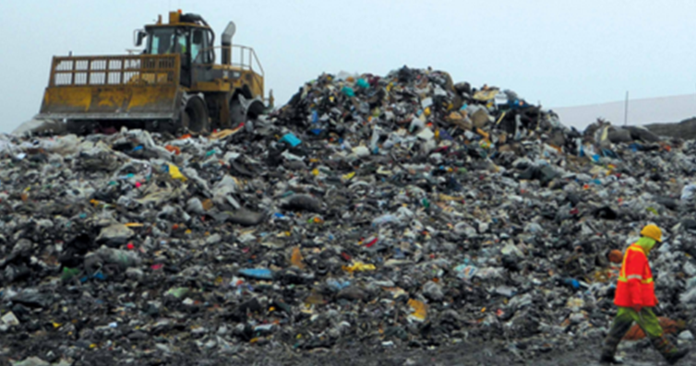
ANNEX
Summary of Q&As

Slide 27
Summary of responses :
Participants were asked: Waste could get collected by using more bins to separate out different recyclable items, such as paper and card or glass and metal. This could generate higher value recycling but would require extra effort by householders and potentially take up more space (more, but smaller bins)? The overwhelming majority were not keen on this. Only a couple of participants were not sure, and this was largely due to concerns over compliance
Not Keen
Not Sure
How do you feel about this?
“And if we then sort of try and separate out again on another level, people will get easily confused. It’s all just gonna go in the black bin”
“I would do this, but these things only work if everyone does it”
“I think we don't want recycling centres in our kitchens or in our homes, so like others have said, we've not got space like kitchens are already full busy places to have another couple of bins to get things sorted”

Slide 28
Summary of responses :
Participants were asked: Waste collection vehicles can be expensive, polluting and disruptive to other road users. If alternatives, such as bigger bin capacity was offered to larger households, would this make a less frequent bin collection of your bins more manageable? All respondents answered no for reasons summarised in the quotes below
No
“Every two weeks is tolerable, but only just. Especially when you've got children. It's just on the precipice.”
“can you imagine the smell if it was sitting there for 3 weeks.”
How do you feel about this?
“I'm not sure you could physically stretch it any longer than 2 weeks.”
“There’s accessibility issues and storage issues here.”

Slide 29
Summary of responses
Participants were asked: With the waste industry responsible for around 12% of all the UKs greenhouse gas emissions, How important is reducing your waste? All participants felt this was quite important.
Quite important
“There are bigger issues with greenhouse gas emissions then sorting out our recycling.”
“Obviously, if it's saying that, you know, reduce greenhouse gas emissions and whatnot, but also it's not enough to move me to want less frequent collections.”
“I’m not sure about this question. Is the 12% from the vehicles? If that’s the case get more energy efficient vehicles…. “
“Its not more important than my time and convenience”

Slide 30
Summary of responses :
Participants were asked: When you go shopping - Do you try to avoid buying excessively packaged items? Responses were categorised into ‘occasionally’ and ‘never’, although participants implied that this was rarely an active choice, but rather predetermined by suppliers.
Occasionally
Never
“I do occasionally, like if I’m in the supermarket I’ll buy fruit and veg loose. I really hate it when they package that.”
“I do most of my shopping online…I know the packaging is likely to be excessive but that’s what I want to buy”
“It’s not something you can avoid is it?”

Slide 31
Summary of responses :
Participants were asked: Have you tried using refillable containers? All responses were categorised as never and occasionally. The ‘occasional’ explanations illustrated that this was not part of lifestyle choices but rather convenience and availability.
Never
Occasionally
“It just seems like a bit of a fuss, remembering to take your container. The practicality of remembering to take the cereal containers out with you, to get to the shops to get more cereals. I just don't know if it's really realistic for me”
“I use a refillable coffee cup, does that count?”
“I have bought a pouch to refill my coffee jar…. But its not always available”
“I think its gonna take a while for that to take off”

Slide 32
For further questions, please contact:
Claire.Bennett@melresearch.co.uk

